Slide 2

Quality Assurance Using Computer Vision
Domantas Jurkus

Slide 3
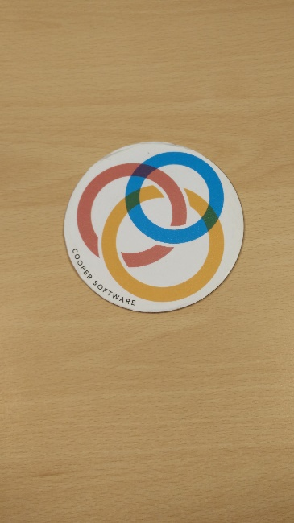
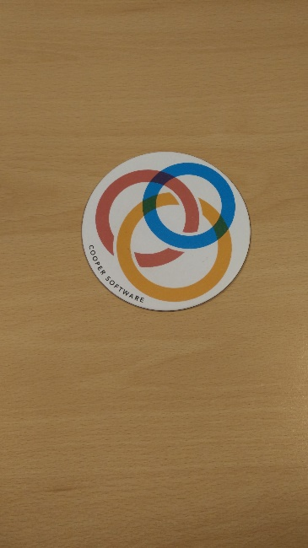
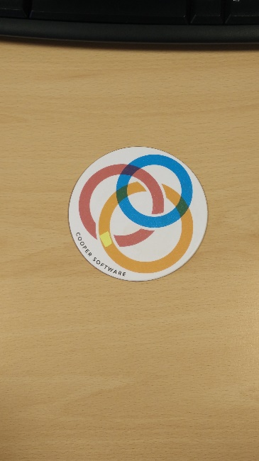
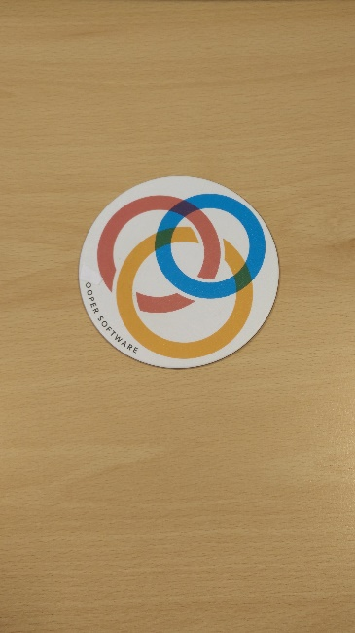
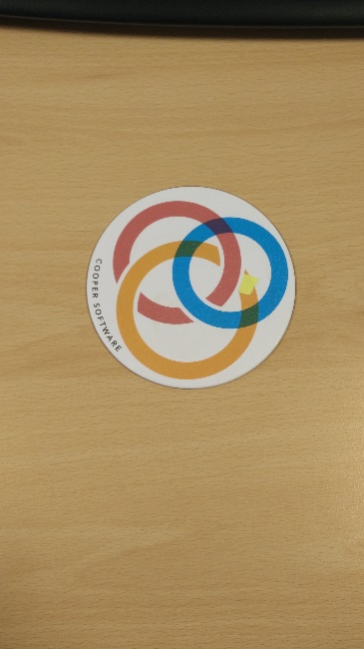
Challenge: automatically detect which coasters are “damaged”

Slide 4
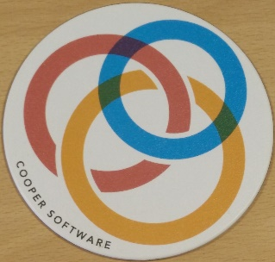
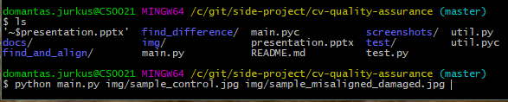
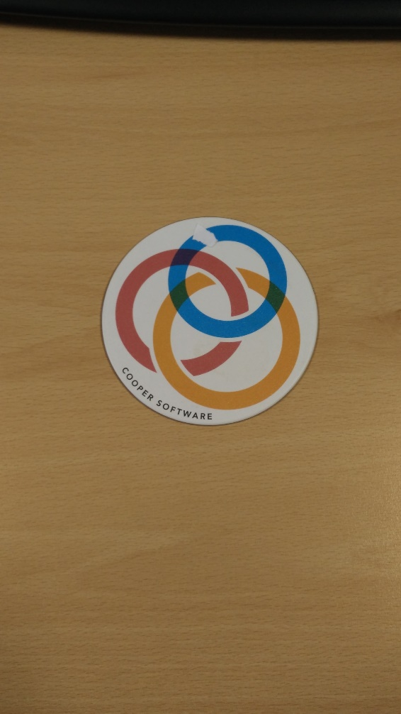
General Use
PRODUCTS
CONSULTING
SUPPORT
Control
Quality score [0,100]
Script
Query

Slide 5
Approach
Find and align:
1. Find and match features (distinctive areas)
2. Rotate, align and crop query image
Find difference:
1. Subtract the images
2. Present difference in numeric format

Slide 6
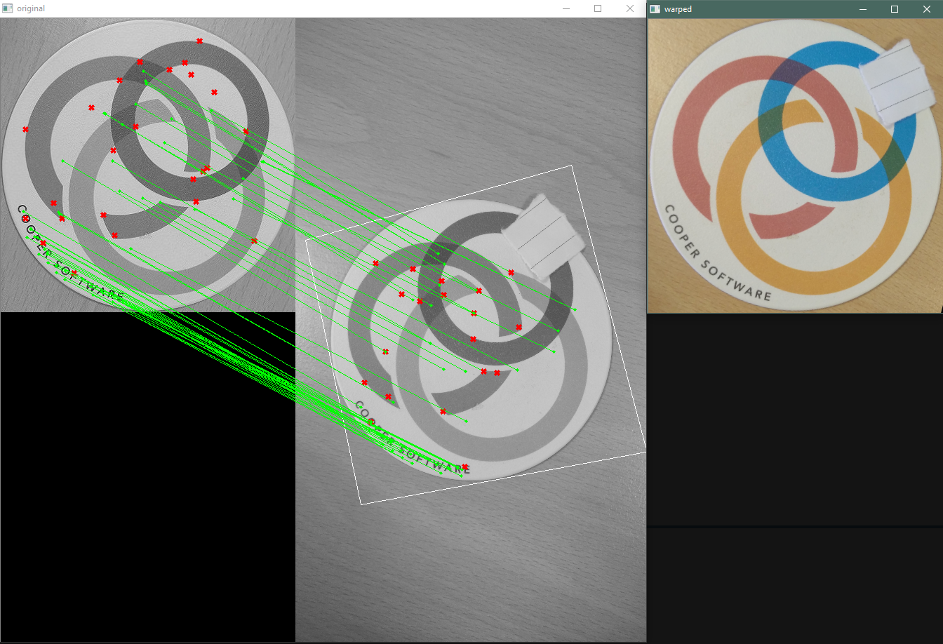
Feature Detection + Matching
Feature detection: SIFT algorithm (patented)
Alternative: BRISK (free to use)
Feature matching: brute-force
Alternative: FLANN (patented, possibly faster)

Slide 7
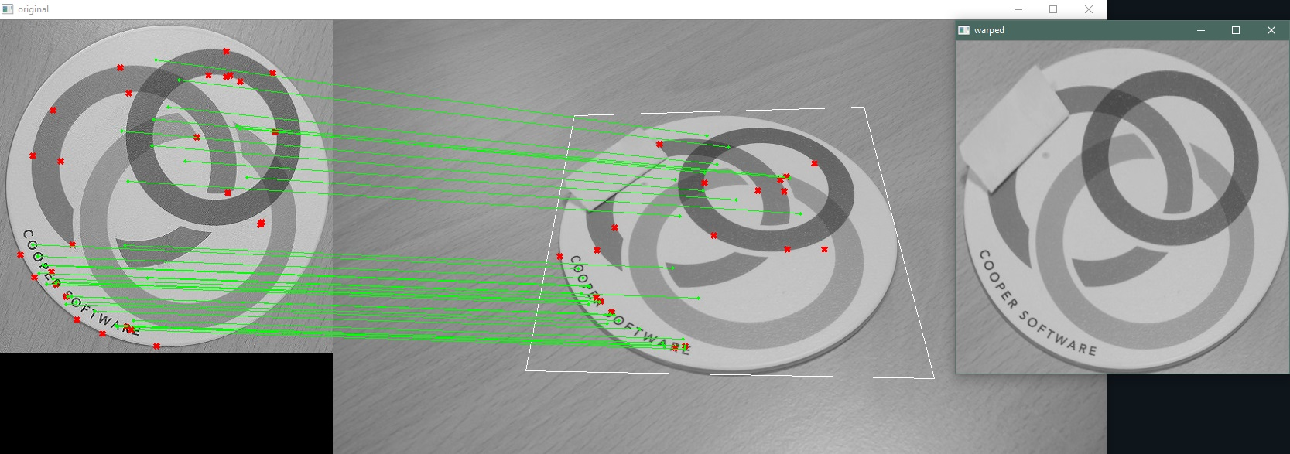
Feature Matching

Slide 8
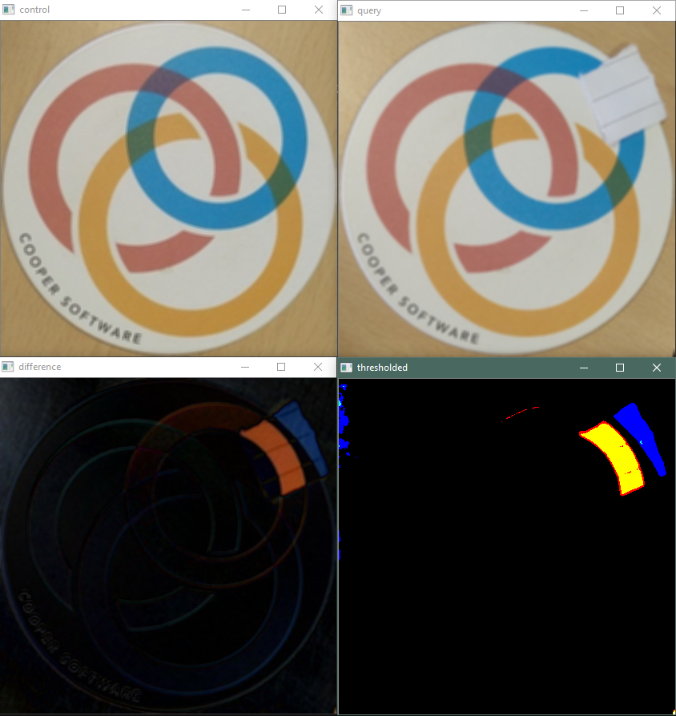
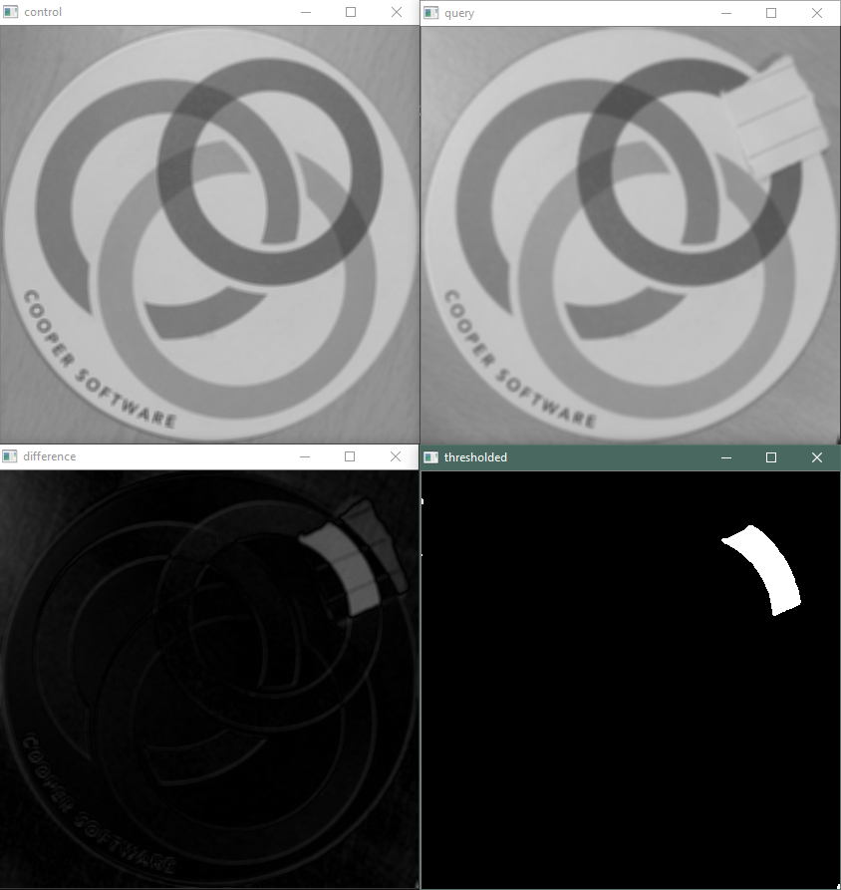
Image Difference

Slide 9
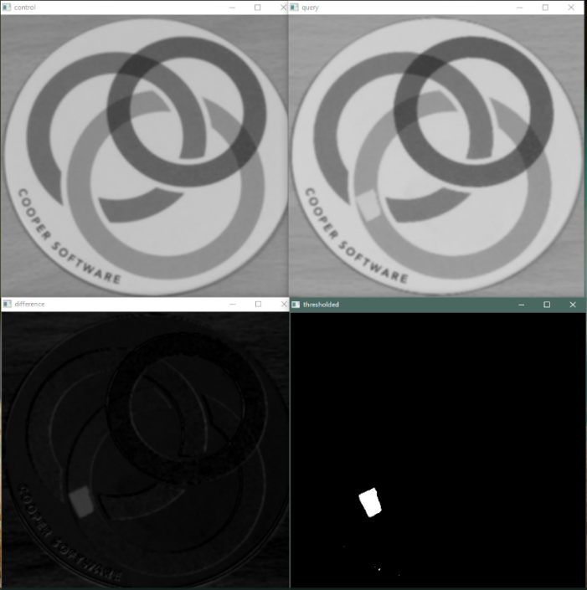
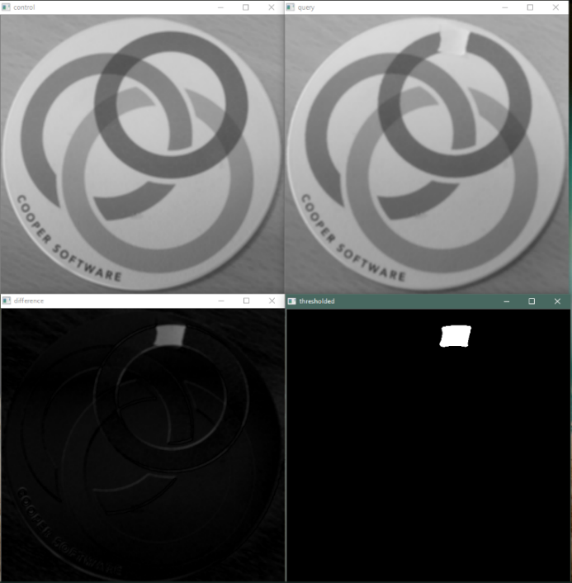
Good finds

Slide 10
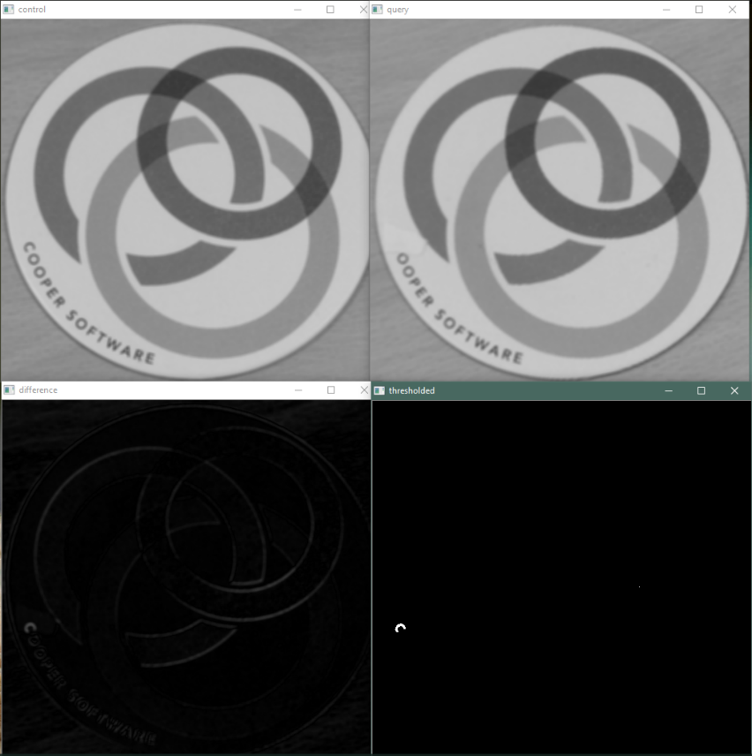
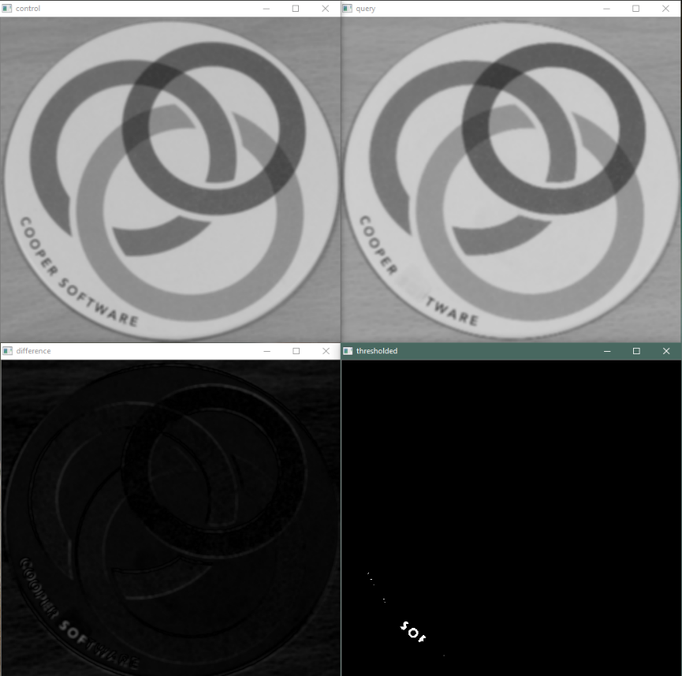
Fine details

Slide 11
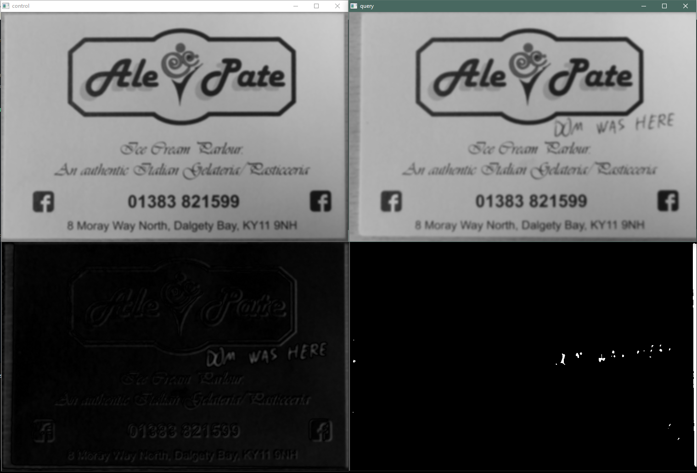
Generalisation

Slide 12
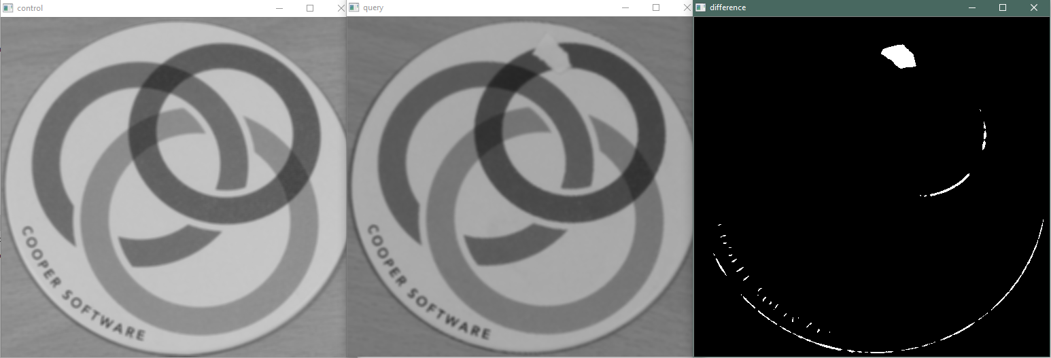
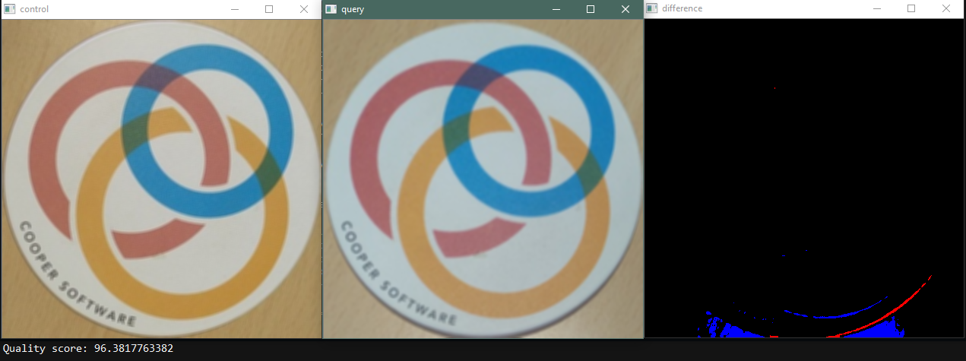
Problems: Misalignment

Slide 13
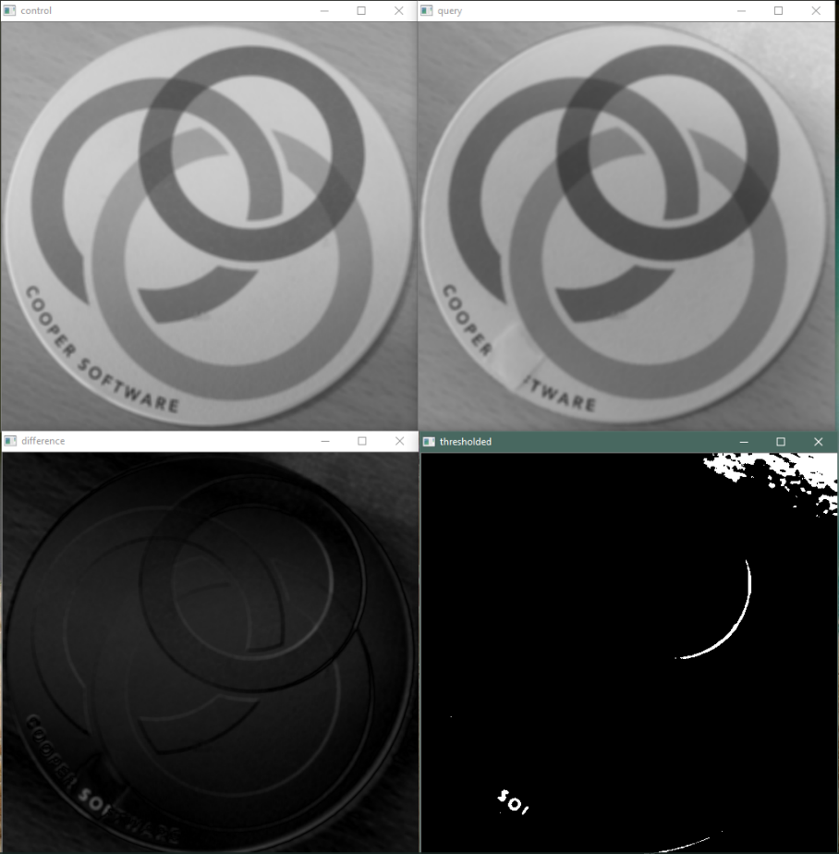
Problems: background noise

Slide 14
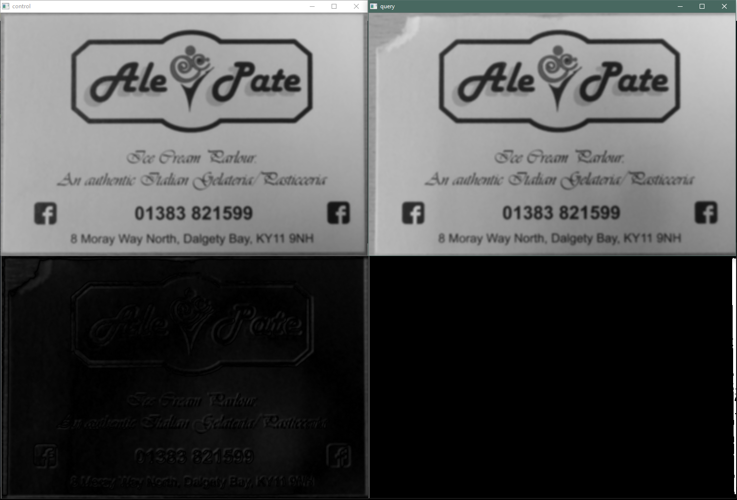
Problems: background

Slide 15
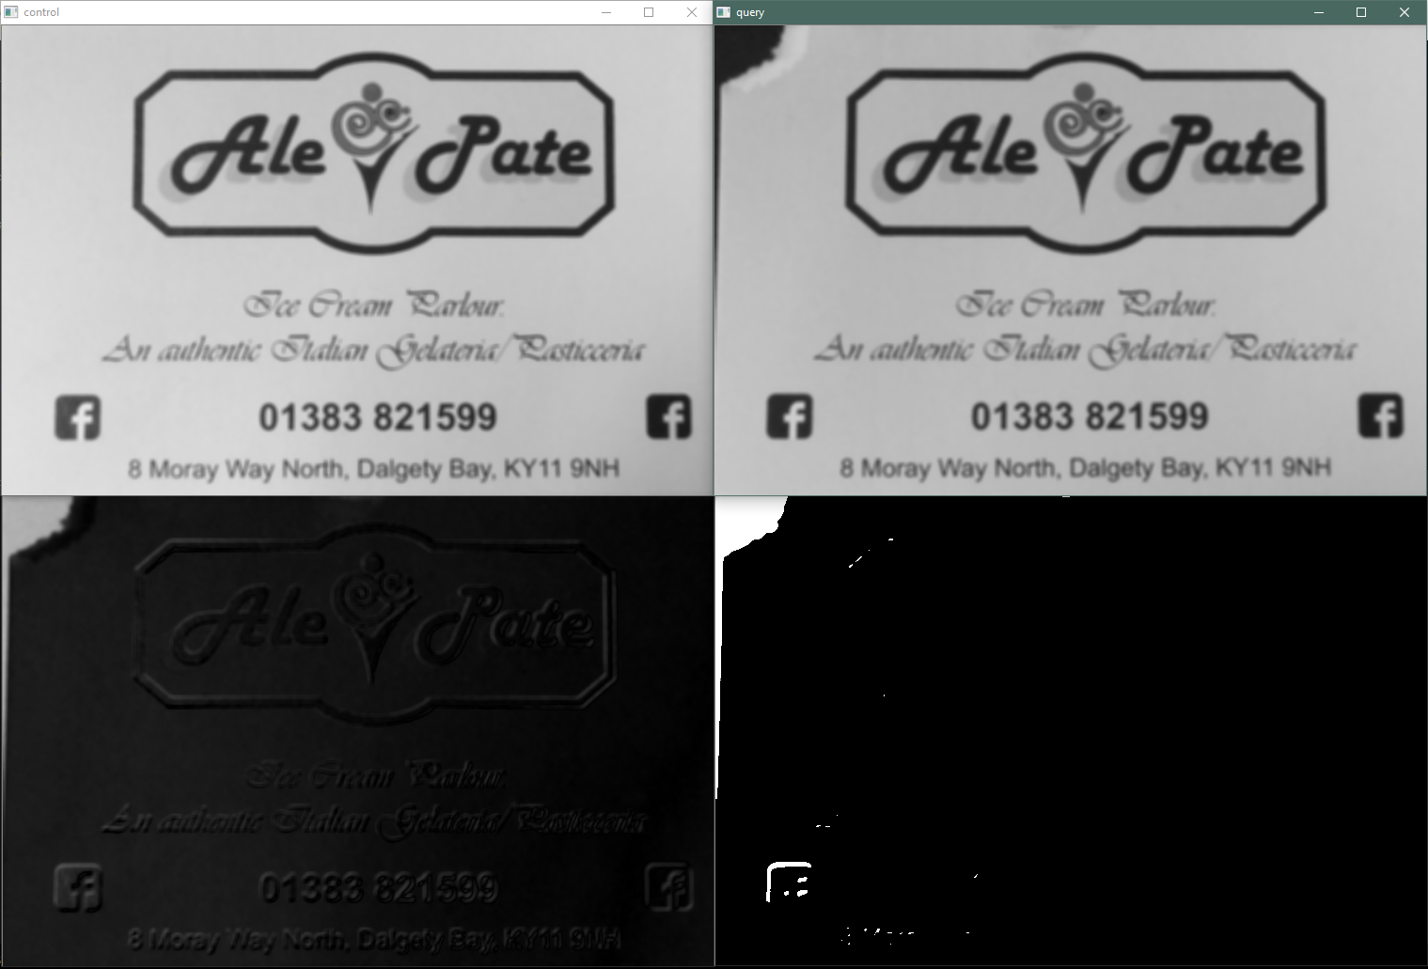
Dark (Contrast) background

Slide 16
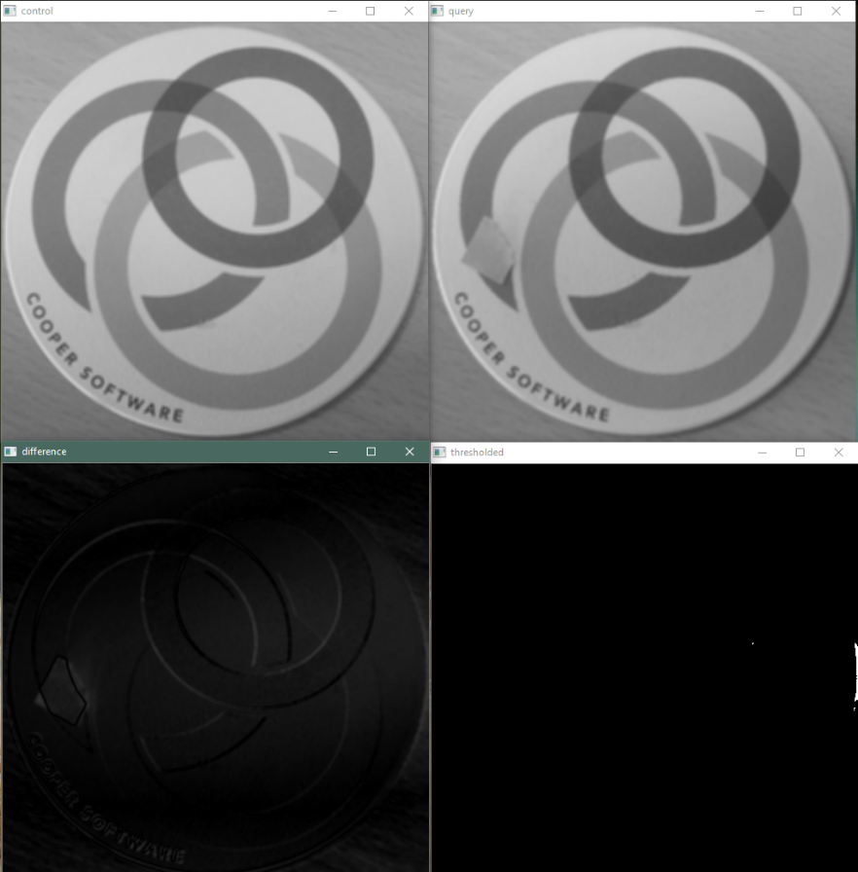
Problems: Lighting/Thresholding

Slide 17
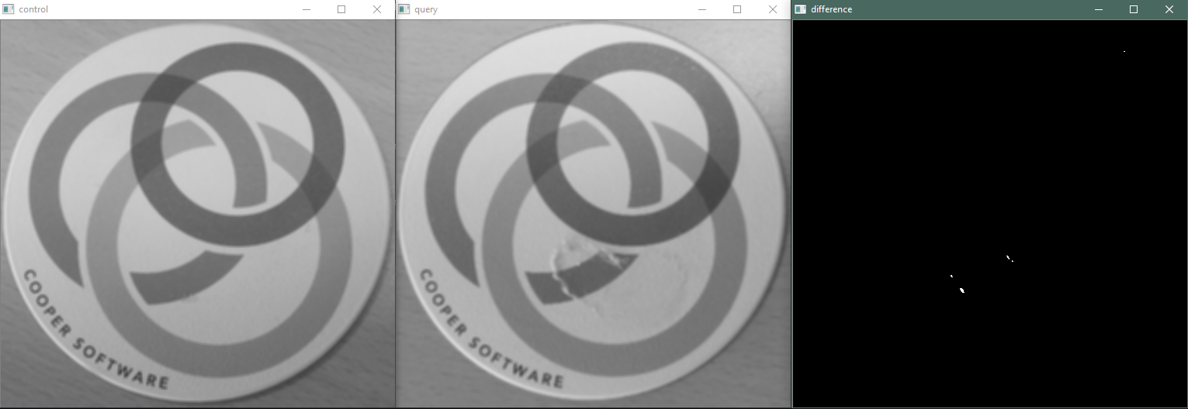
Actual damage detection (?)

Slide 18
Improvements
Misalignment:
- blurring/erosion/dilution (reduces accuracy)
- fixed 90° camera
Background:
- product shape detection (circle, rectangle)
- high contrast background
Lighting:
- controlled environment

Slide 19
Nice-to-haves
Detection algorithm:
- change from SIFT (patented) to free alternative (BRISK)
Auto-thresholding:
- somehow calculate how much white counts for damage
Final score:
- take regions of white into account rather than naïve sum approach

Slide 20
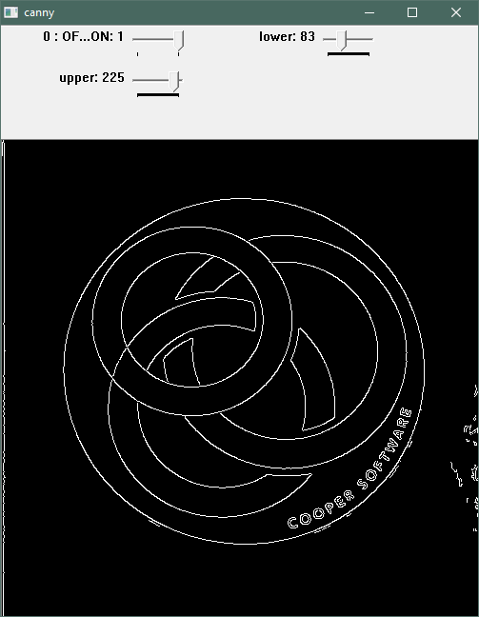
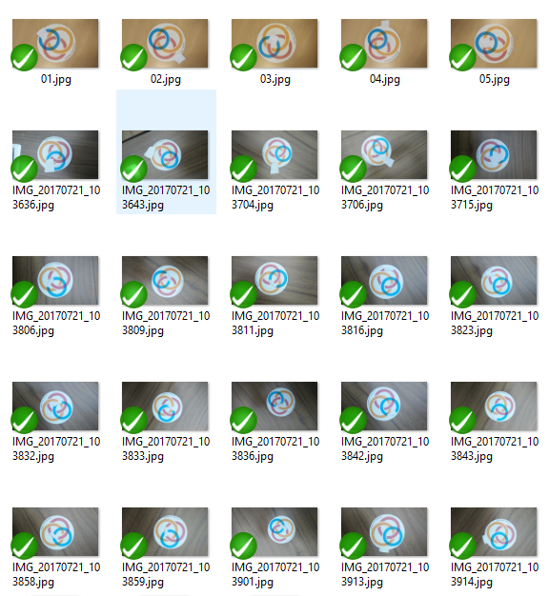
Dropped approaches
Canny edge detection
More sensitive to misalignment
Difficult to take colours into account
Machine learning approach
Requires large set of bad samples
Relies on model selection

